Slide 1
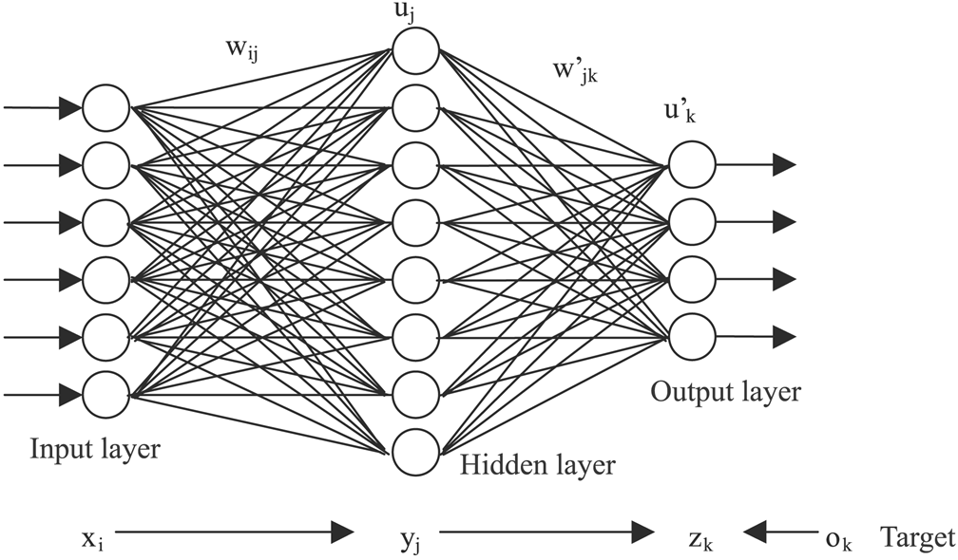
Diagnosing parkinson’s from handwriting samples
CS 274c
Robert Logan
Anthony Chen
Pratik Shetty
Shreya Chippagiri

Slide 2
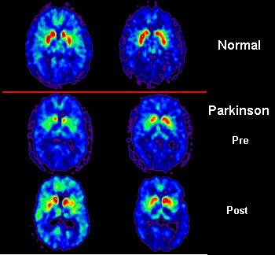
parkinson’s?
What is

Slide 3
parkinson’s DISEASE
A disorder of the central nervous system that affects movement, often including tremors.
Nerve cell damage in the brain causes dopamine levels to drop, leading to the symptoms of Parkinson’s.
Often starts with a tremor in one hand. Other symptoms include slow movement, stiffness, and loss of balance.
Medications can help control the symptoms of Parkinson’s.

Slide 4
Can’t be cured, but treatment may help
Requires a medical diagnosis
Lab tests or imaging often required
Chronic: can last for years or be lifelong
Ages affected

Slide 5
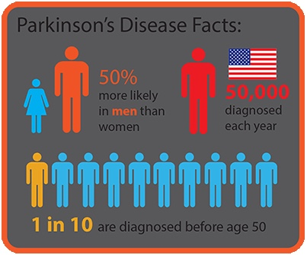
why did we choose parkinson’s?
Parkinson's Disease (PD) automatic identification in early stages is one of the most challenging medicine-related tasks to date, since a patient may have a similar behavior to that of a healthy individual at the very early stage of the disease.

Slide 6
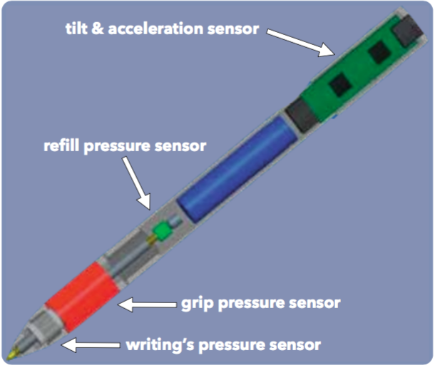
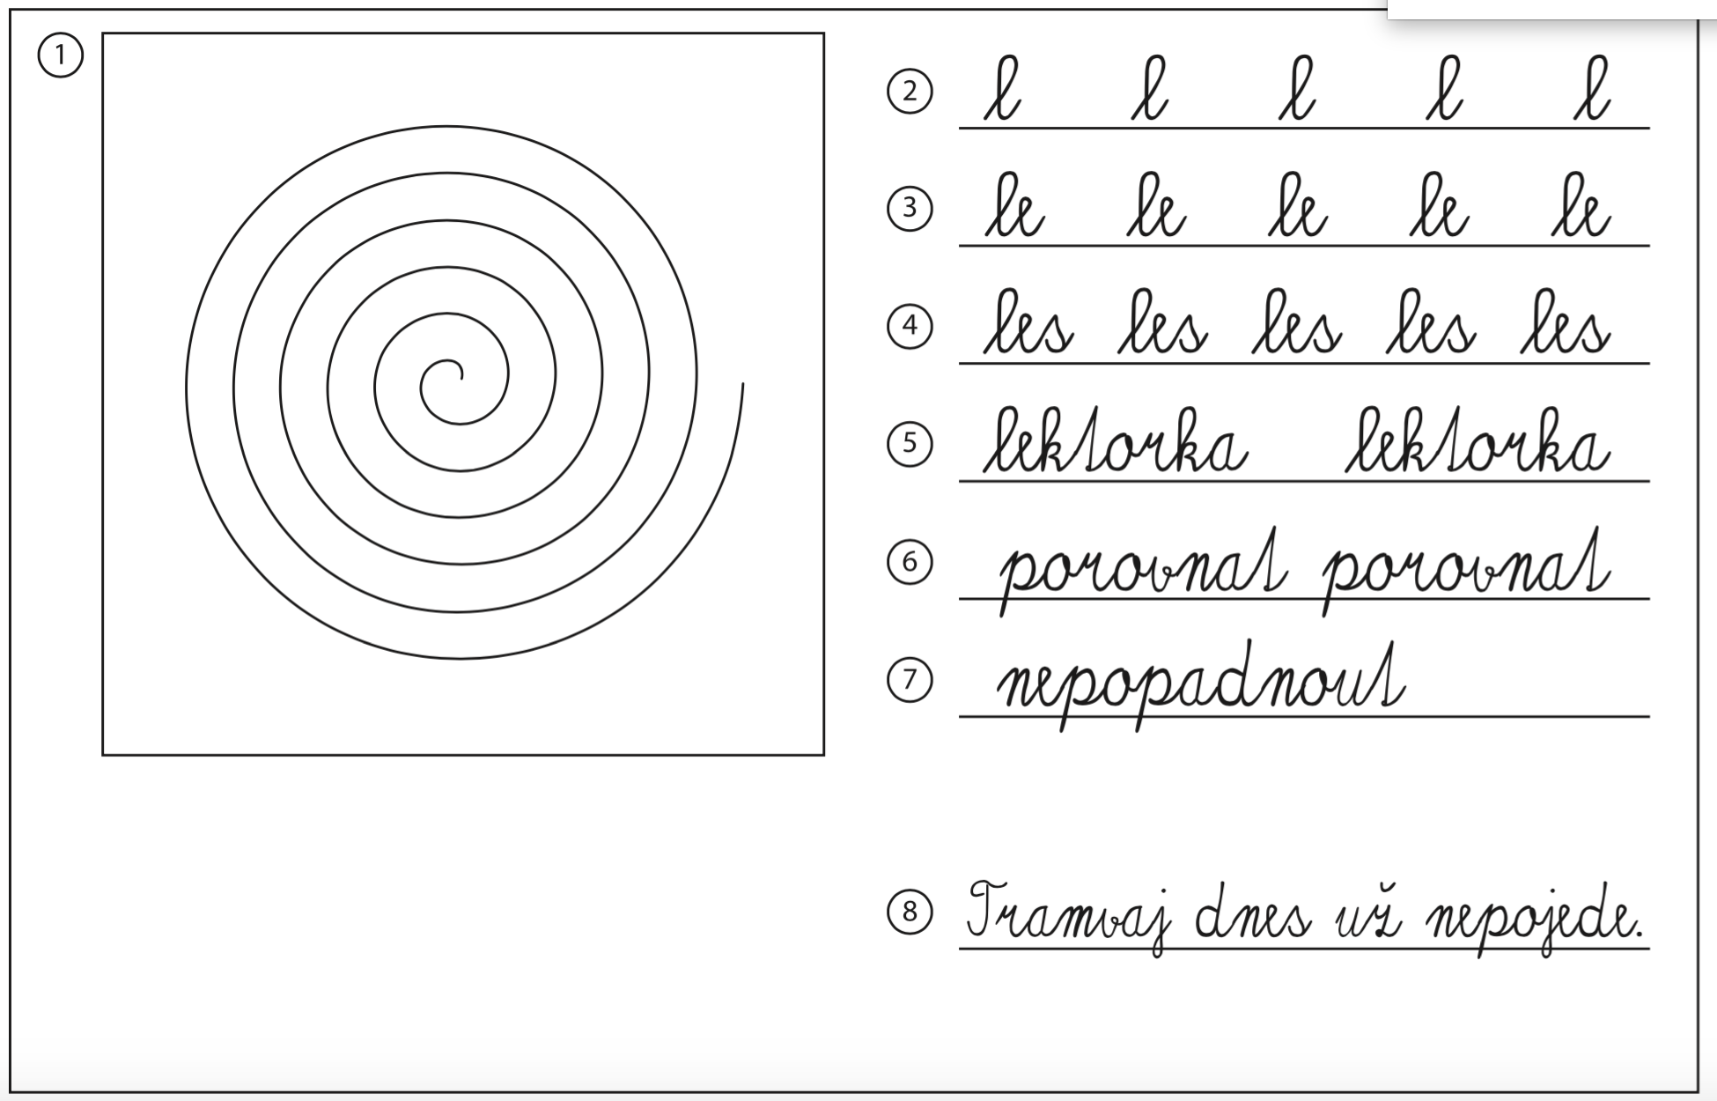
the dataset
Parkinson’s Disease Handwriting Database (PaHaW) - Brain Diseases Analysis Repository (BDALab), Czech Republic
In-air and on-surface kinematic variables during handwriting
37 PD patients on medication and 38 age and gender matched healthy controls
Features provided: X coordinate, Y coordinate, timestamp, button state, azimuth, altitude and pressure
Features extracted: X velocity, Y velocity, X acceleration, Y acceleration, X jerk, Y jerk, velocity, acceleration, jerk, azimuth velocity, altitude velocity, pressure velocity

Slide 7
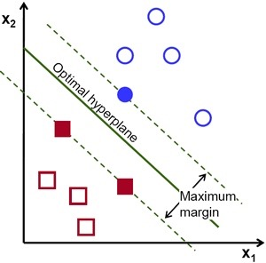
previous studies
Support Vector Machines (SVMs) -
Sesa-Nogueras, Enric, Marcos Faundez-Zanuy, and Jiří Mekyska. "An information analysis of in-air and on-surface trajectories in online handwriting." Cognitive Computation 4.2 (2012): 195-205.

Slide 8
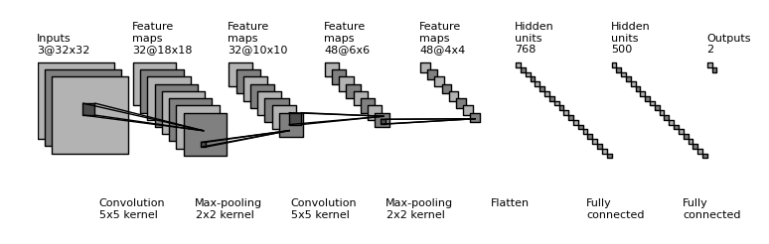
…previous studies
Convolutional Neural Networks (CNNs)
Pereira, Clayton R., et al. "Deep Learning-aided Parkinson’s Disease Diagnosis from Handwritten Dynamics."

Slide 9
modeling approaches

Slide 10
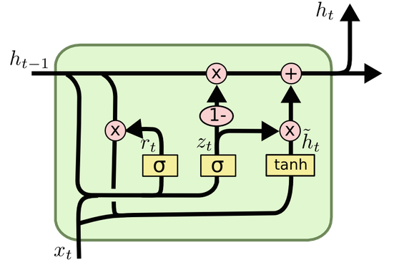
Long Short Term Memory
(Lstm)
Our Approach 1:

Slide 11
Long Short Term memory (LSTM)
Long short-term memory (LSTM) is a recurrent neural network (RNN) architecture (an artificial neural network) proposed in 1997 by Sepp Hochreiter and Jürgen Schmidhuber.
Like most RNNs, an LSTM network is universal in the sense that given enough network units it can compute anything a conventional computer can compute, provided it has the proper weight matrix, which may be viewed as its program.
Unlike traditional RNNs, an LSTM network is well-suited to learn from experience to classify, process and predict time series when there are time lags of unknown size and bound between important events.

Slide 12
LSTM
Model specifications
16 unit LSTM layer
32 unit dense layer with ReLu activation function
32 unit dense layer with ReLu activation function
Sigmoid output

Slide 13
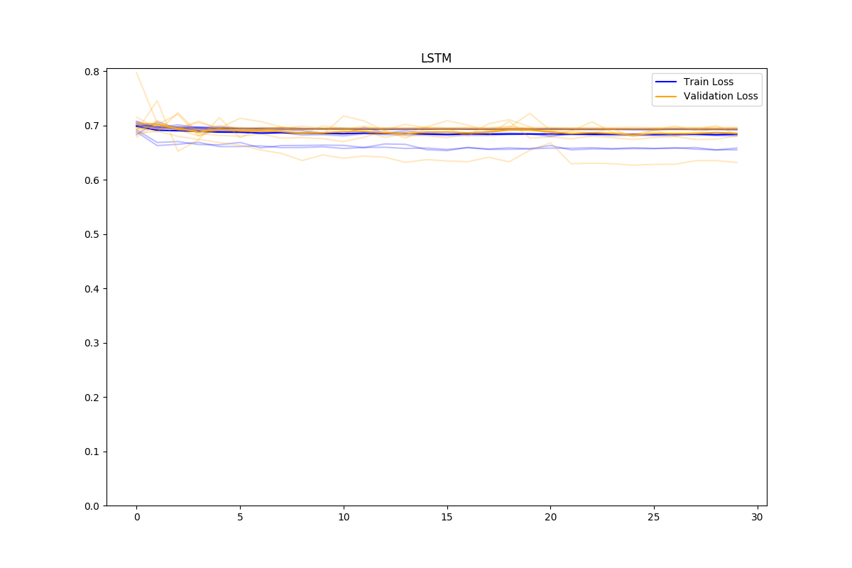
LSTM
Model observations
Accuracy: 51%

Slide 14
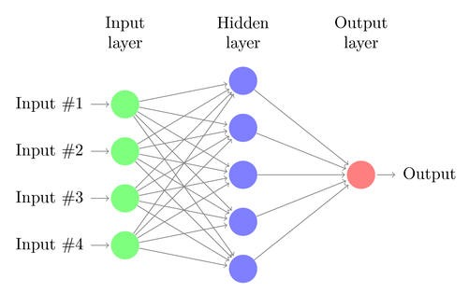
Feed forward
Our Approach 2:

Slide 15
Feed forward
A feedforward neural network is a biologically inspired classification algorithm. It consist of a (possibly large) number of simple neuron-like processing units, organized in layers.
Every unit in a layer is connected with all the units in the previous layer. These connections are not all equal: each connection may have a different strength or weight.
Data enters at the inputs and passes through the network, layer by layer, until it arrives at the outputs. During normal operation, that is when it acts as a classifier, there is no feedback between layers.

Slide 16
feed forward
Model specifications
Hidden layers: 1, 35 unit, ReLu activation function, 50% dropout
L2 regularization with weight of 0.1
In-air and on-paper features such as standard deviation velocity, standard deviation acceleration , standard deviation jerk, range of horizontal jerk, range of horizontal acceleration, minimum vertical jerk, 99th percentile vertical velocity, 75th percentile horizontal velocity

Slide 17
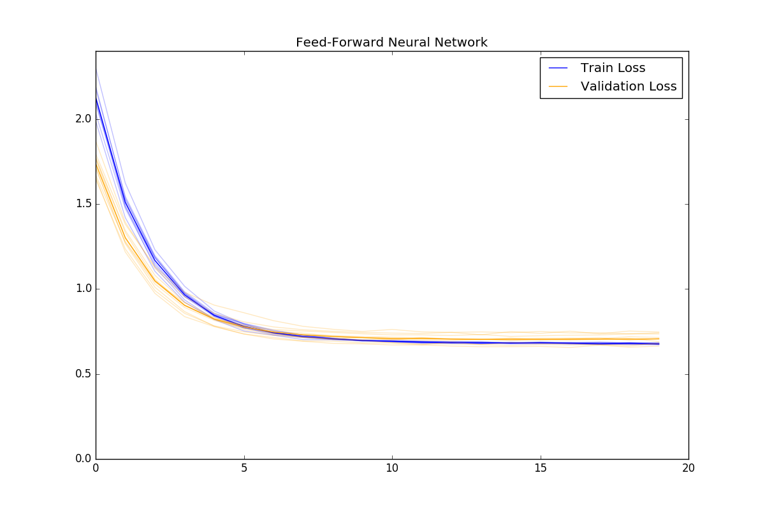
feed forward
Model observations
Accuracy: 62%

Slide 18
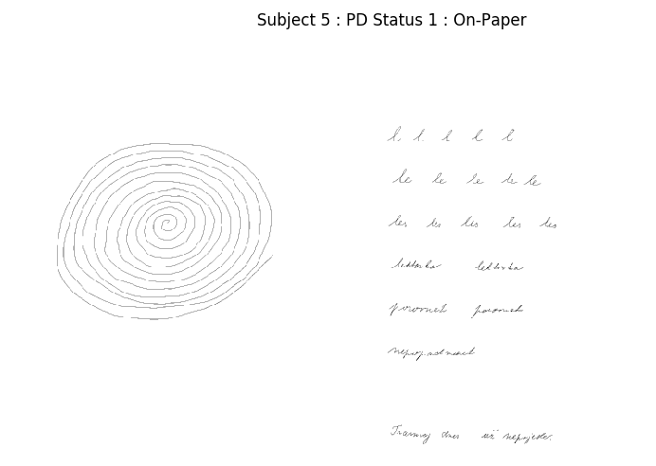




Slide 19
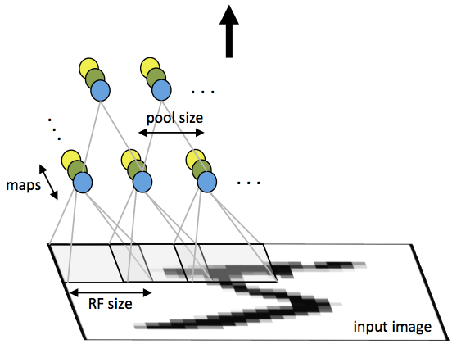
Convolutional neural network(CNN)
Our approach 3:

Slide 20
Convolutional neural network (Cnn)
A Convolutional Neural Network (CNN) is comprised of one or more convolutional layers (often with a subsampling step) and then followed by one or more fully connected layers as in a standard multilayer neural network.
The architecture of a CNN is designed to take advantage of the 2D structure of an input image (or other 2D input such as a speech signal). This is achieved with local connections and tied weights followed by some form of pooling which results in translation invariant features.
Another benefit of CNNs is that they are easier to train and have many fewer parameters than fully connected networks with the same number of hidden units.

Slide 21
cnn
Model specifications
Input: Image of size 300x500
Hidden Layers: 2x8-unit 3x3 convolutional layers with ReLu activation function
2x2 max pooling layer (50% dropout)
8 unit dense layer with ReLu activation function (50% dropout)
1 unit dense layer with Sigmoid activation function
L2 regularization apple to all layers
Accuracy estimated using 10-fold cross validation
Number of training epochs: 50

Slide 22
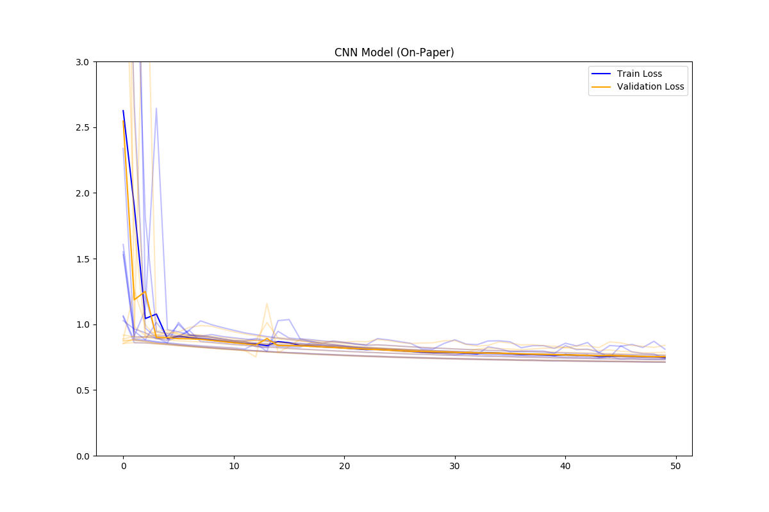
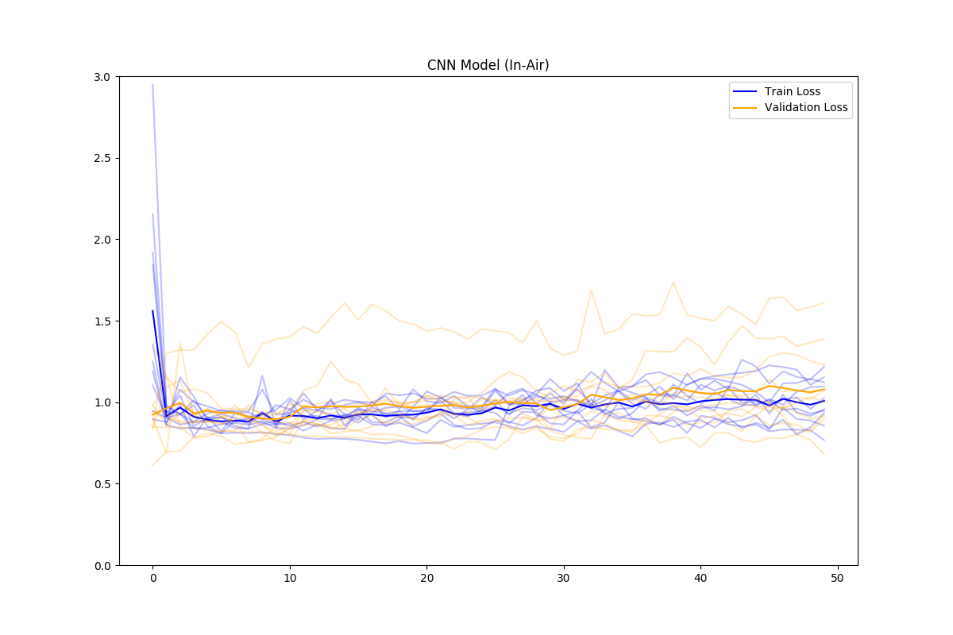
cnn
Model observations
On Paper
Accuracy: 54%
In Air
Accuracy: 69%

Slide 23
Learnings so far…
& Future work?

Slide 24
Questions?

